Slide 1

Balanced scorecard slide 1
HISTORY OF
TEST SERIES IN CRICKET
List of all test Series played since 1877 between the 8 major test playing teams with no. of matches played, won, lost and drawn
Kedar Joshi

Slide 2
PRESENTATION OUTLINE
PROBLEM STATEMENT
EXECUTIVE SUMMERY
BASIC ANALYSIS
CONCLUSION

Slide 3
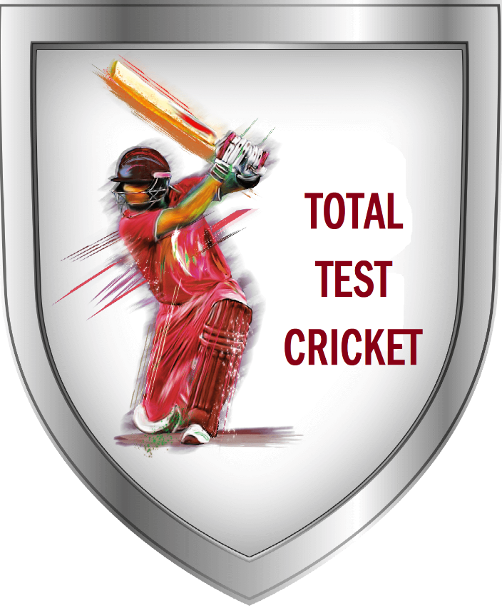

Balanced scorecard slide 3
PROBLEM STATEMENT
To know the History of Test Series in Cricket and to derive the meaningful insights from the data and to provide the visualization in terms of different charts and graphs.
SOURCE OF DATA
https://www.kaggle.com/arihant94/history-of-test-series-in-cricket

Slide 4

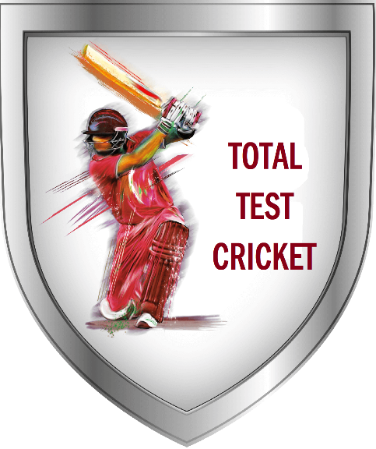


Balanced scorecard slide 2
EXECUTIVE SUMMERY
TOTAL MATCHES PLAYED
MATCHES PLAYED BY INDIA
Total matches played in the international test series by the 8 major teams are 2131.
India has played 259 International Test Series Matches in which 95 won, 51 lost and 113 matches were drawn.
In the International Test Series Cricket Australia Cricket Team has the best performance. Australia has played 417 matches in which 236 won, 99 lost and 82 drawn.
In the International Test Series Cricket New Zealand Cricket Team has the worst performance. New Zealand has played 197 matches in which 49 won, 62 lost and 86 drawn.
BEST PERFORMING TEAM
WORST PERFORMING TEAM
Presentation Video Link :
https://drive.google.com/file/d/1zsndChmHEiGcNazkK5UzTaXoBHCB8E9l/view?usp=sharing

Slide 5
Balanced scorecard slide 4
BASIC ANALYSIS
This chart gives overview of the entire Test Cricket. All the teams are showing there performance in played matches.
England has played more no. of matches than any other team and Sri Lanka has played less matches.
Australia performed Excellent. They played total 417 matches in which 236 won, 99 lost and 82 were drawn.
New Zealand’s team performance is weak compared to all other teams. From 197 matches they won just 49 matches.

Slide 6
BASIC ANALYSIS
Australia performed very well. Australia played maximum matches against the England.
India’s performance in the Test Cricket is good. India played maximum matches against England.

Slide 7

BASIC ANALYSIS
New Zealand’s team performance is weak compared to all other teams. From 197 matches they won just 49 matches.
Pakistan played 177 matches in which they won 67 matches and lost 32 and 78 matches were drawn.

Slide 8


BASIC ANALYSIS
South Africa played total 225 test matches in which they won 97 matches. SA played maximum matches against England.
West Indies played total 238 test matches in which they won 81 matches. 61 matches they lost and 96 were drawn.

Slide 9


BASIC ANALYSIS
Sri Lanka Test Cricket Performance can be visualize through the graph associated. Out of 121 matches played Sri Lanka won 42 matches.
England has played maximum no. of matches than any other team. Total matches played by England is 503. England has played maximum matches with Australia.

Slide 10
Balanced scorecard slide 7
CONCLUSION
Australia has best performance in the Test Cricket.
New Zealand the has worst performance.
England has played maximum no. of matches.
Sri Lanka has played minimum no. of matches.
Australia won maximum no. of matches i.e. 236.
Sri Lanka won minimum no. of matches i.e. 42.

Slide 11
Balanced scorecard slide 10
THANK YOU

